Slide 1

Amazon Product Reviews Analysis
A presentation by :-
RIGVED SAROUGI
ROHIT ARYA
SANDIP BEZ
SHAMEEK CHAULIA

Slide 2
Acknowledgement
We would like to express our special thanks and gratitude to our mentor.
"Dr Nidhi Chahal" for her kind support and guidance in completing our project.
We would also like to extend our gratitude to the NIIT and all our mentors for providing us with the facilities that we required.

Slide 3

introduction
Customers are more likely to purchase from a website that has positive customer reviews.
Analyzing past data on product reviews for:
Improvement on their existing products.
Forecast sales in the future.
Reviews not only have the power to influence consumer decisions but can strengthen a company's credibility.
Therefore, predicting the user rating from the text reviews is critically important.

Slide 4

Business objectives
Identifying customer reactions in order to better understand and improve the business.
Extraction of product names from the reviews.
Forecasting customer sentiments from reviews to understand the trend.
Analysing the relations between the two datasets.

Slide 5

DATA SOURCE
Amazon product data :
Product reviews
From April 1998 to July 2014
Categories :
1. Toys & Games
2. Video Games

Slide 6
Visualization of input data
Importing the necessary libraries
Importing data from the files
Cleaning the review data
Visualization through Tableau

Slide 7

ANALYSING customer reactions to understand and improve the business
For sentiment analysis TextBlob method is used.
Fetching out the polarity scores for particular text reviews.
Classified the polarity scores into 4 different sentiments:
Highly Positive : >0.5
Positive : 0.1 to 0.5
Neutral : 0
Negative : < 0

Slide 8
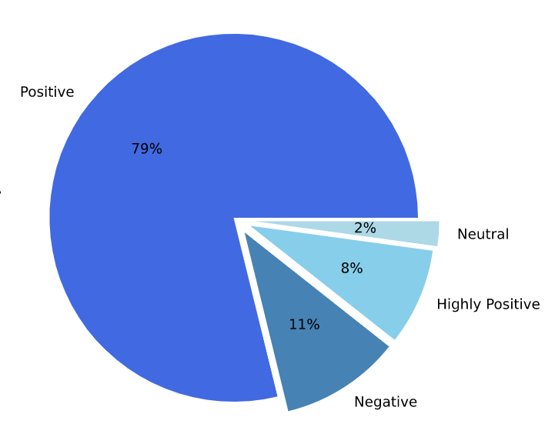
customers reaction : Toy Games
Reviews (Input) | Sentiments (Output)
Some people hate monopoly, others love it. Me.. | Neutral
It took over 20 years, but we finally have the ultimate Battle Cat.. | Positive
I know one little girl who is happier because of this doll! | Positive
We bought this, waste of money…. | Negative
Recommend others…. Loved it.. | Highly Positive

Slide 9
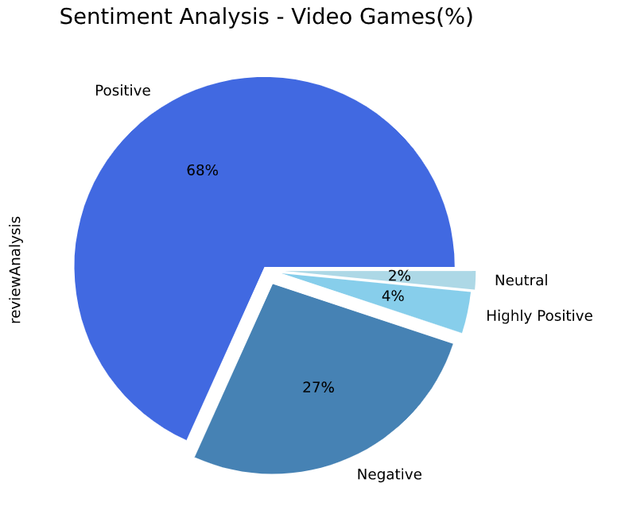
customers reaction : video Games
Review (Input) | Sentiment (Output)
Another Great Pokémon Game, Son loves this game!.. | Positive
Fun in small doses, but maybe a little too cut... | Neutral
Shooters highly enjoyed wish shooters played like Killzone 2…. | Positive
Son hates this game!.. | Negative
The best I have seen in the market.. | Highly Positive

Slide 10
Extraction products names: toy games
Product Id | Reviews (Input) | Product Name (Output)
0980223644 | just like Wits & Wagers Family, it features family-friendly meeples on the reverse of the answer boards……. | Wits & Wagers
0975277383 | Shadows over Camelot is so fun and different! I have never played anything like it before……. | Camelot
0979712386 | I purchased the Speedy Diner Game, and life suddenly became worthwhile and fun! This toy is best combined with any Gordon Ramsay DVD…… | the Speedy Diner Game
0979959330 | Party Gras is fun from the start. It doesn't take more than a minute to get going. Players ask each other questions and depending on responses take or give up beads. Because you play one category per card, then discard, the options are open,……... | Party Gras
We have used NER(Name Entity Recognition) method to extract the product names.

Slide 11
Extraction products names: video games
Product Id | Reviews (Input) | Product Names (Output)
B000006RGQ | It's another good Assassin's Creed game. The formula remains the same-- Run around, climb buildings (or trees), synchronize on towers, get contracts, kill people, hide in crowds, etc…….. | Assassin's Creed
B000006RGR | This game lacked the ability to live up to name "Tomb Raider" its more of a "City Raider" half the levels deal with city-time scenery. and 80% of the enemies are humans….. | Tomb Raider
B00000DMAE | Even though this game is almost 15 years old and uses a modified Quake engine, it is still one of the most FUN and best shooters ever to be made…... | Half Life 1
B00000DMAM | a humanoid lizard design and have a mouth design that looks just like that of a Predator………… | Predator
We have used NER(Name Entity Recognition) method to extract the product names.

Slide 12

Future forecast OF SENTIMENTS
For the purpose of future forecast, we have made use of time series SARIMA model. The time period for following category :
Toys and Game(Actual values) – From year 1999-2014
Toys and Game(Forecast values) – After year 2014
Video Games(Actual values) – From year 2000-2014
Video Games(Forecast values) – After year 2014

Slide 13

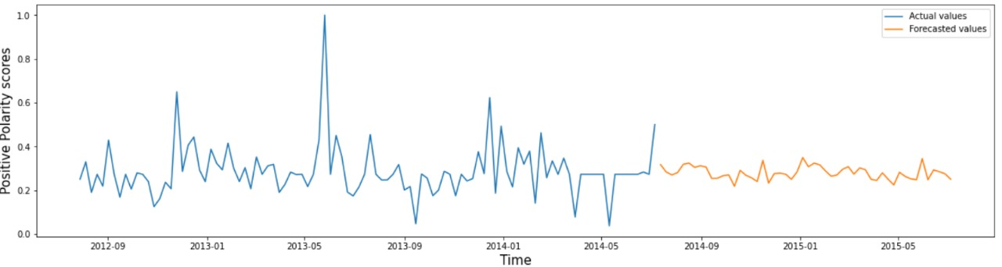
Future trend (Toy game- Roly Poly)
Positive sentiments
Time
INSIGHTS:
Trend shown is for one product only i.e. Roly Poly.
Positive review tends to be constant after July 2014 till July 2015.

Slide 14
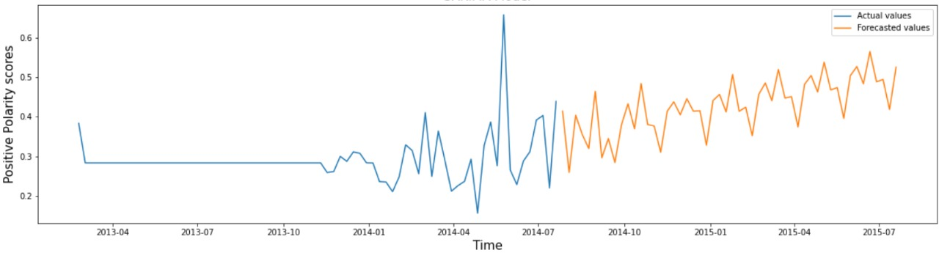
Future trend (video game-Assassin’s creed)
Positive sentiments
Time
INSIGHTS:
Trend shown is for one product only i.e. Assassin's Creed.
Positive review tends to be increasing after July 2014 till July 2015.

Slide 15

Analysing the relations between
the Video Games
and
Toys & Games datasets

Slide 16
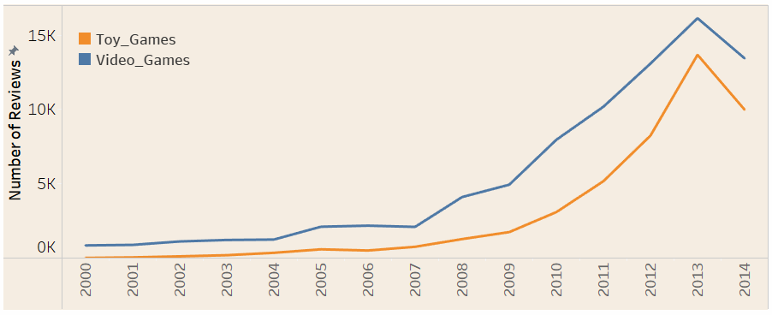
Trend of reviews
Years
INSIGHTS:
Review trend seems to increase till 2013 and after that sudden decrease is there.
The number of reviews for Toys and Games is comparatively lower than Video Games.

Slide 17

COMMON customers
Amazon Customer
Armando N Roman
Chris
John
B. E Jackson
Rondy
Henri Sav
Mike Wahl
Jandsm
Sideshow Bob
ChastStrategos
We have about 4.79% of common customers in both the datasets.

Slide 18
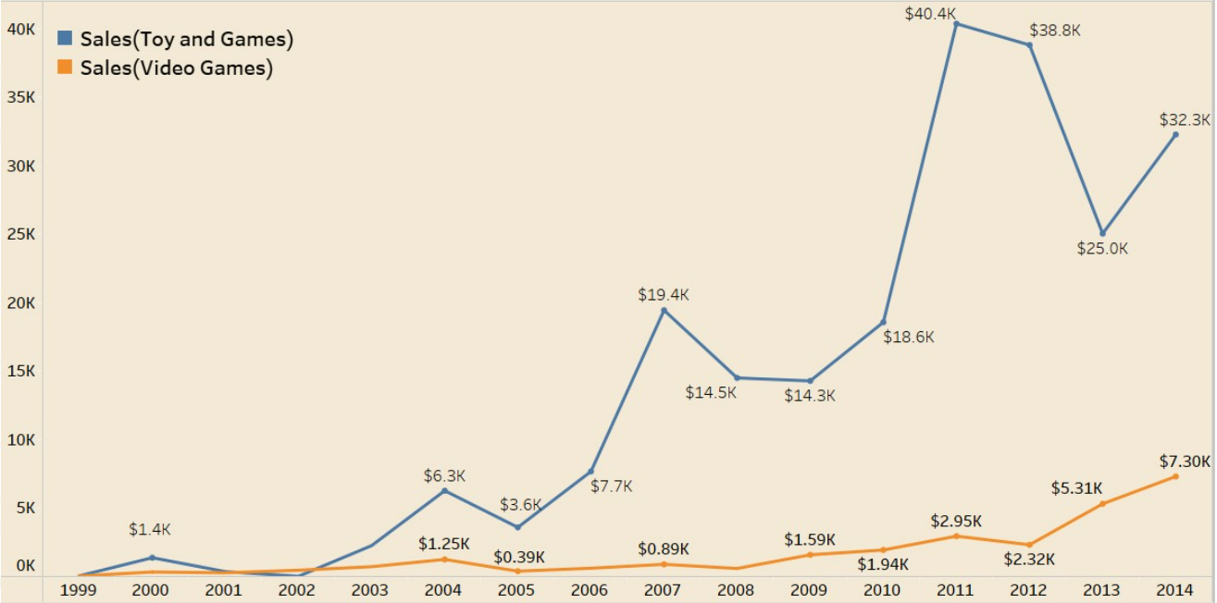
Sales over the years for both datasets
Sales
Years
INSIGHTS:
Overall sales have increased in both datasets since 1999.
Sales of toy products are higher than sales of video game products.

Slide 19

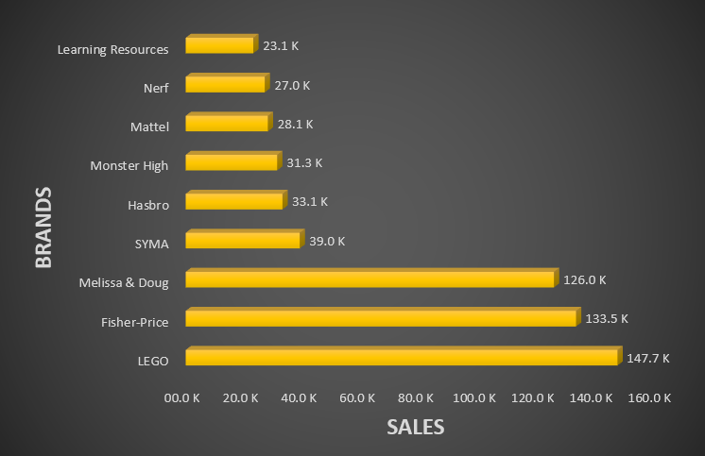
BRANDWISE SALES
Brands | Total Sales($) | Reasons (Reviews)
Learning Resources | 23103.97 | Awesome ... cute .. affordable .. and American...
Nerf | 27041.89 | My 3 year old loves this game!
Mattel | 28099.33 | Great
Monster High | 31284.22 | A Family Favourite
Hasbro | 33092.72 | "I like Candyland"
SYMA | 38983.56 | Finding Nemo
Melissa & Doug | 125965.2 | just what we were looking for
Fisher-Price | 133512.7 | Good for kids
LEGO | 147696.6 | Nice toy

Slide 20
Product wise sales
Brand Names | Product Names | Total Sales($)
Melissa & Doug | Light Puzzle Rack | 978.18
Melissa & Doug | m&d | 1538.9
LEGO | Minecraft | 2004.6
Battat | Matchbox | 2286
Mattel | Scattergories | 2539.8
Playskool | Playskool | 3469.02
REASON: High quality, affordable, variety of choice, great addition
Toys like Playschool and Battat are the most popular, but some models are defective in these segments.

Slide 21
UNDER-PERFORMING PRODUCTS
Product Names | Brand Names | Average Sales($)
Chomp | Gamewright | 9.99
The Ravensburger Snail's | Ravensburger | 16.59
Turtles | Nickelodeon | 27.99
Skittles | Spin Master Games | 32.65
UPS | Vetch | 32.99
Reasons: Defective, durable, expensive, boring, versions, installing, bad looking, bad colors, etc.

Slide 22
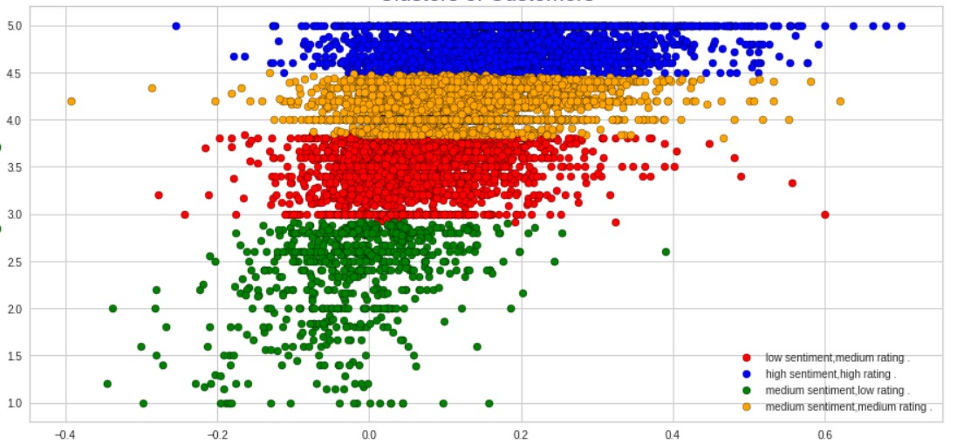
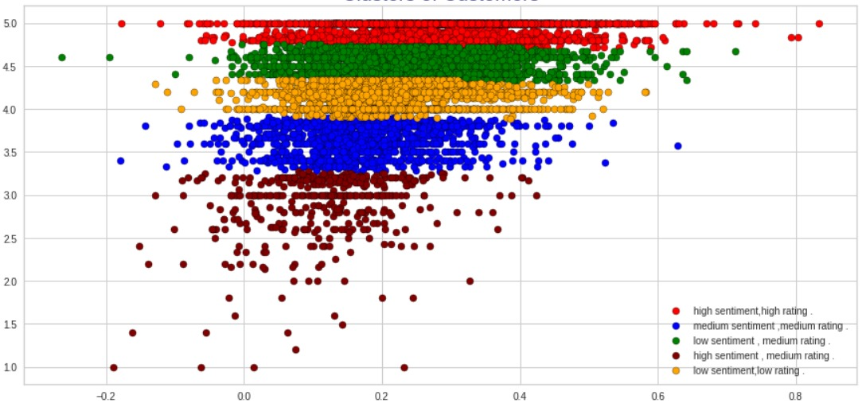
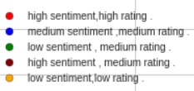

clustering
Video games dataset
toy & games dataset
Ratings
Ratings
Sentiments
Sentiments
We got best results using KMEANS clustering.

Slide 23
PRODUCTS Recommendation system
Video games dataset
toy & games dataset
Product ID | Product Name
B00005TNI6 | "Devil May Cry"
B00BGA9WK2 | "Blacklight Retribution"
B003JVKHEQ | "Call of Duty: Black Ops"
B0000696CZ | "Tomb Raider: Angel of Darkness”
B002I0H79C | "Call of Duty 4: Modern Warfare"
Product ID | Product Name
B001W30D2O | Learning Puppy
B0006N8X3M | CB open
B000VO3GPG | Baby Stella
Product ID (Product Name)
B00BGA9WK2 (Call of Duty Ghost)
Product ID (Product Name)
B00BGA9WK2 (Leap Pad)
To determine the linear correlation between two variables, in this case, the ratings for two products, we utilise Pearson's correlation coefficient.

Slide 24

conclusions
Positive sentiments are more in number than negative sentiments.
Negatively reviewed products have low sales.
Some of the most popular brands have the highest sales, but only a small percentage of their products are defective. (i.e., Playskool, Battat).
Toys & Games dataset has higher influence on sales as compared to Video Games.
We have about 4.79% of common customers in both the datasets.

Slide 25

SUGGESTIONS
Some brands (such as Playskool and Battat) and some items (such as Chomp and Matchbox) require quality improvement.
Businesses must raise the calibre of their goods while also marginally lowering their prices.
The business needs to concentrate on the customers who have expressed moderate sentiments.
We may leverage our suggestion system, which offers incredibly comparable items for comparison and better product selection, to expand business.

Slide 26


